Slide 1
بسم الله الرحمن الرحیم
Notes:
Introduce yourself
ان شاء الله که وخت خوب و پربرکت خواهیم داشت

Slide 2
CS101 Introduction to Computer Science

Slide 3
Lecture 5

Slide 4
conditionals

Slide 5
operators

Slide 6
=
<
<=
>
>=
==
!=
…

Slide 7
variables

Slide 8
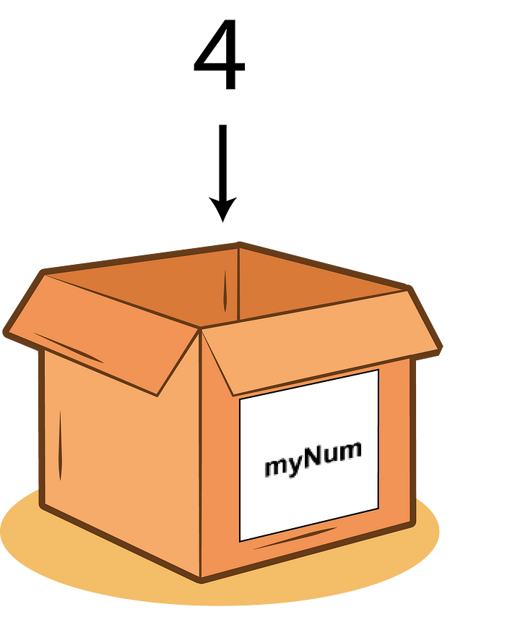

Slide 9
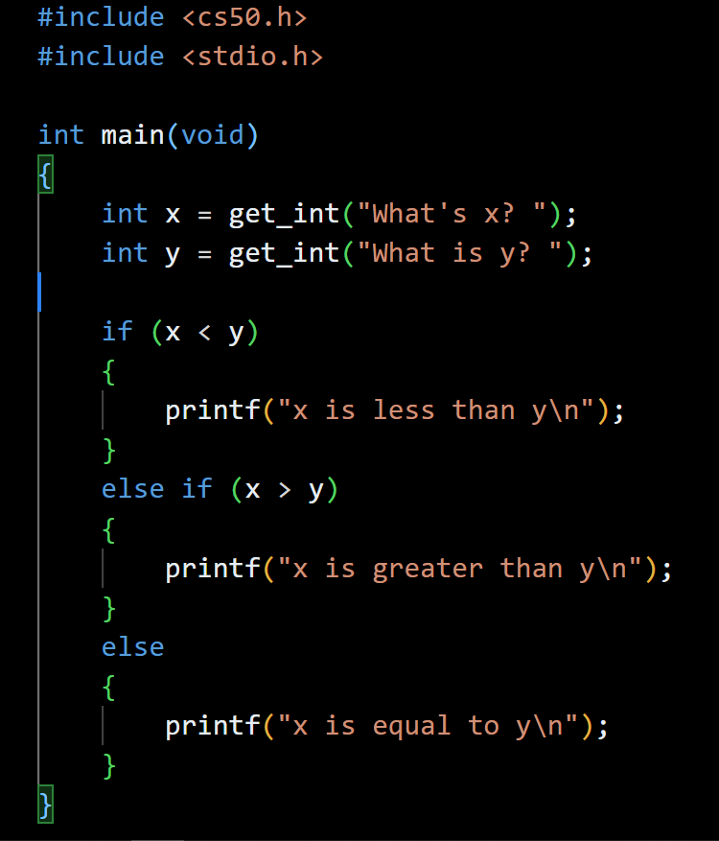

Slide 10
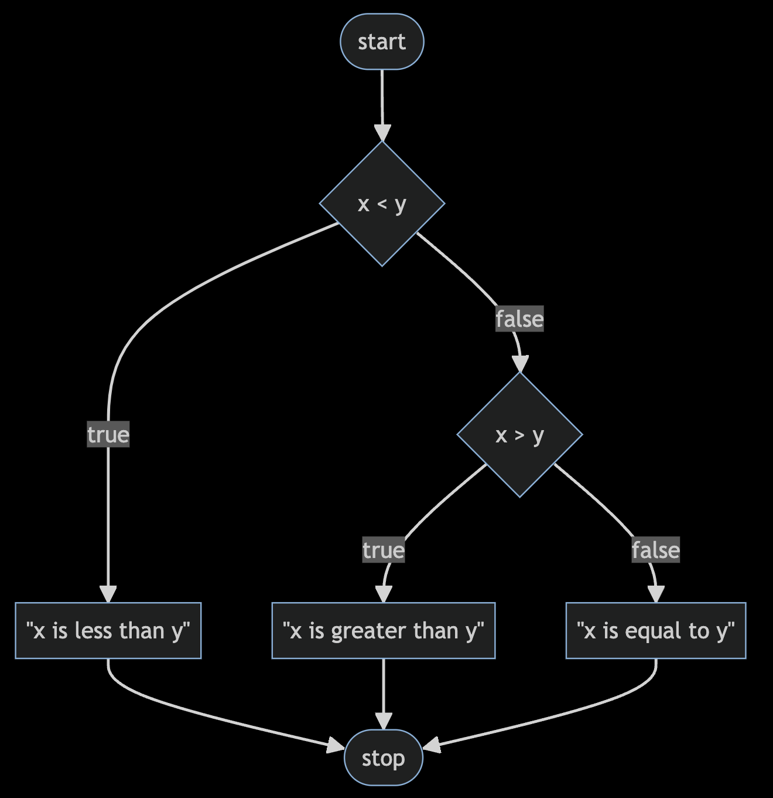
Notes:
compare4.c
https://mermaid.live/edit#pako:eNptkctOwzAQRX9lNGyolP5AQJVonYoNK1hRZzGK3SYisVM_RKMo_45jKxUReOU5M_dqHiNWWkjM8dzq76om4-CDcQXhvTyerAug3MB2u4P9eINnGKaU3AcGzngZc4cTx4er1-7pBo2FVloLriYFQ6Icy1-yM7U26Vjw3N092cqzWHtejCQnzf-2bG17XEvl1VMLTv-RHWP16zyn7stNgocEU1AsAWbYSdNRI8KuxjnJ0dWykxzz8BVkvjhyNYU68k6_D6rCfJ4lQ9-L0Dlr6GKowzy2udBCNE6bO5QxfEsXiYfJsCf1qfUinH4AYdKEwg

Slide 11
bool
char
double
float
int
long
string
...

Slide 12
bool
char
double
float
int
long
string
...

Slide 13
get_char
get_double
get_float
get_int
get_long
get_string
...

Slide 14
get_char
get_double
get_float
get_int
get_long
get_string
...
Notes:
agree{0,1,2}.c

Slide 15
loops
Notes:
cat0.c

Slide 16
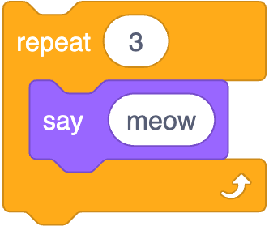
Notes:
https://scratchblocks.github.io/#?style=scratch3&script=repeat%20%5B3%5D%0Asay%5Bmeow%5D

Slide 17
int i = 3;
while (i > 0)
{
printf("meow\n");
i--;
}
Notes:
cat1.c, but use counter first

Slide 18
int i = 3;
while (i > 0)
{
printf("meow\n");
i--;
}
Notes:
cat1.c, but use counter first

Slide 19
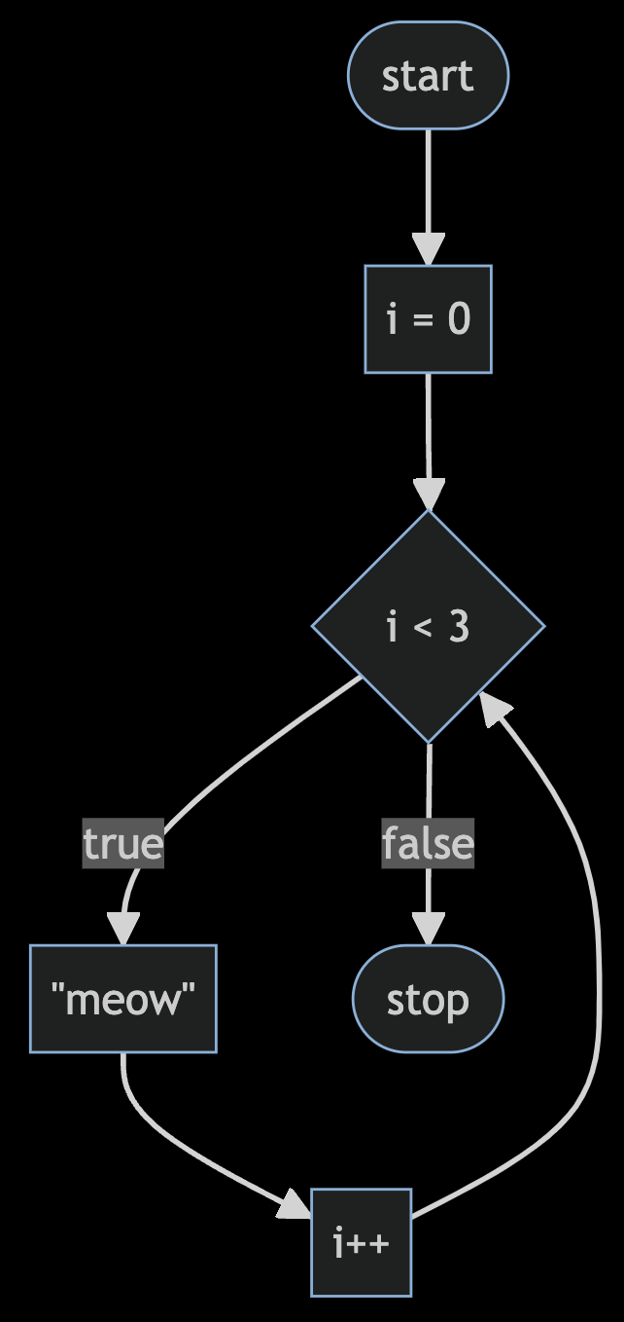
Notes:
https://mermaid.live/edit#pako:eNpNkEFvwjAMhf-KZS4gioS0WzeQgHa3ncaJpgerSUc0EnchFZqq_velCUz4ZH9-fnrygA1LhTm2F741Z3IejoWwEGo3r64-gHoBq9UW9pWGDazrtNxHdhg0vMHLmNghMPCuV3FXVAJnPz37V6P4ljqB9_MiSspKL5d3UibDJ6eWLtdk9T4l4a5eCIsZGuUMaRkyD5NaoD8rowTmoZXkvgUKOwYd9Z4_f22D-ZQpw76T5FWh6cuRwTzaP2gptWf3D1UcP9Jn4oMy7MiemB-H4x_2fV7F

Slide 20
int i = 0;
while (i < 3)
{
printf("meow\n");
i++;
}
Notes:
cat{2,3}.c

Slide 21
for (int i = 0; i < 3; i++)
{
printf("meow\n");
}
Notes:
cat4.c

Slide 22
Notes:
https://mermaid.live/edit#pako:eNpNkEFvwjAMhf-KZS4gioS0WzeQgHa3ncaJpgerSUc0EnchFZqq_velCUz4ZH9-fnrygA1LhTm2F741Z3IejoWwEGo3r64-gHoBq9UW9pWGDazrtNxHdhg0vMHLmNghMPCuV3FXVAJnPz37V6P4ljqB9_MiSspKL5d3UibDJ6eWLtdk9T4l4a5eCIsZGuUMaRkyD5NaoD8rowTmoZXkvgUKOwYd9Z4_f22D-ZQpw76T5FWh6cuRwTzaP2gptWf3D1UcP9Jn4oMy7MiemB-H4x_2fV7F

Slide 23
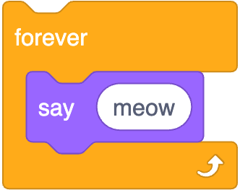
while (true)
{
printf("meow\n");
}
Notes:
https://scratchblocks.github.io/#?style=scratch3&script=forever%0Asay%5Bmeow%5D

Slide 24
while ( )
{
}

Slide 25
while (true)
{
}

Slide 26
while (true)
{
printf("meow\n");
}
Notes:
cat5.c

Slide 27
control-c

Slide 28
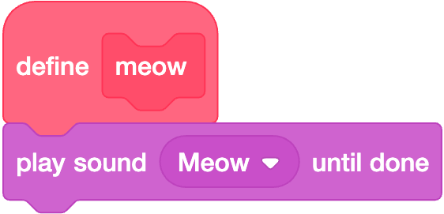

Slide 29
void meow(void)
{
printf("meow\n");
}

Slide 30
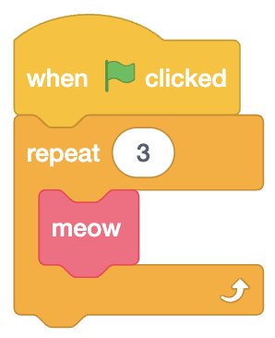

Slide 31
int main(void)
{
for (int i = 0; i < 3; i++)
{
meow();
}
}
Notes:
cat6.c

Slide 32
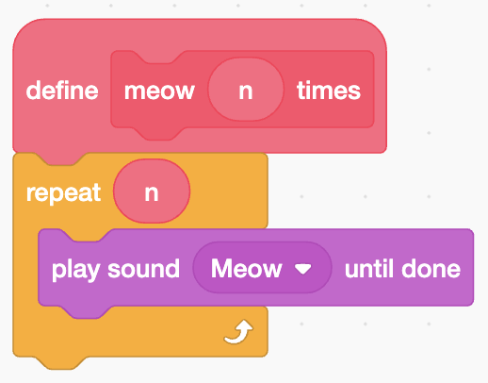

Slide 33
void meow(int n)
{
for (int i = 0; i < n; i++)
{
printf("meow\n");
}
}

Slide 34
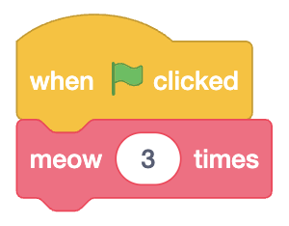

Slide 35
int main(void)
{
meow(3);
}
Notes:
cat{7,8}.c

Slide 36
scope
Notes:
cat9.c

Slide 37

If you'd like a stress ball, what do today's binary bulbs spell?
Notes:
https://emojipedia.org/cookie/

Slide 38
int main(void)
{
meow(3);
}
Notes:
cat{7,8}.c

Slide 39
Linux

Slide 40
correctness, design, style

Slide 41
function
arguments →
→ side effects

Slide 42
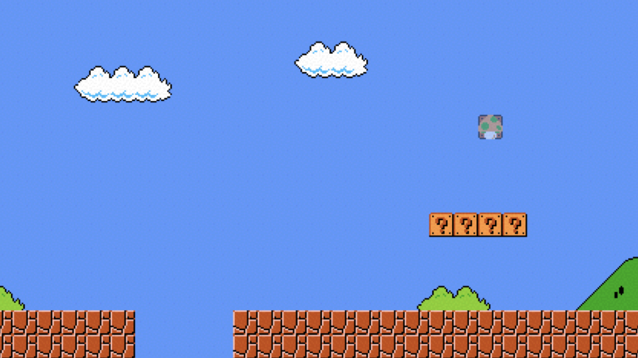

Slide 43
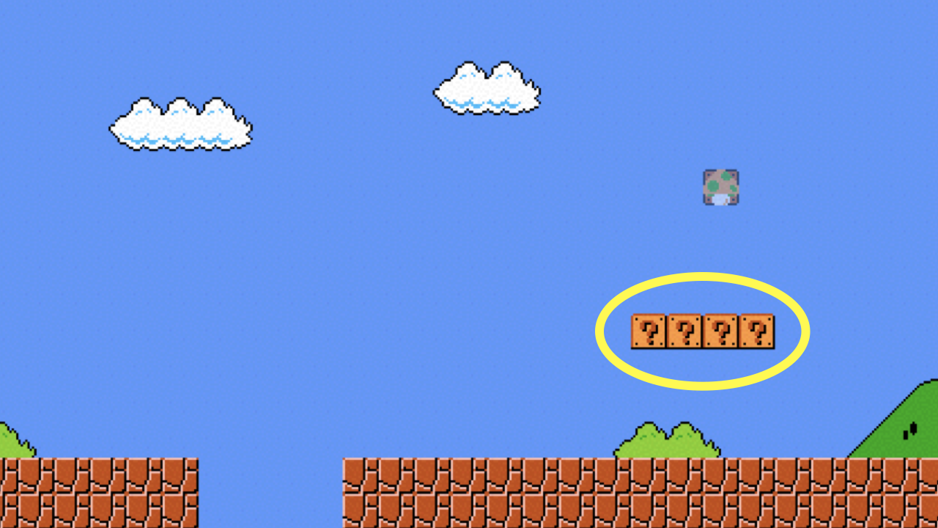
Notes:
mario{0,1}.c

Slide 44
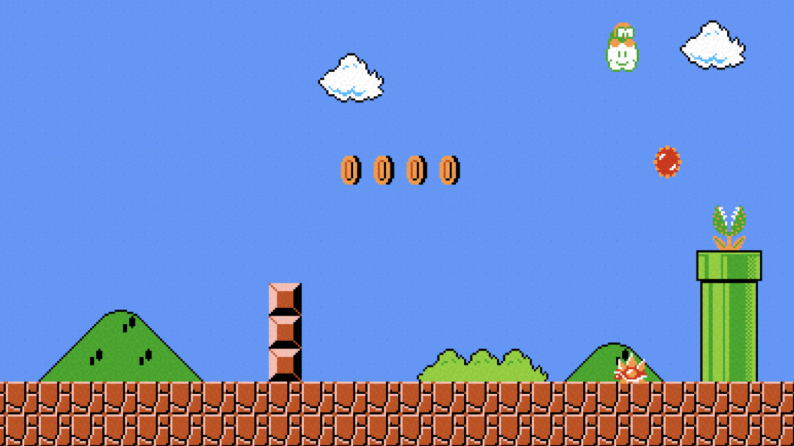

Slide 45
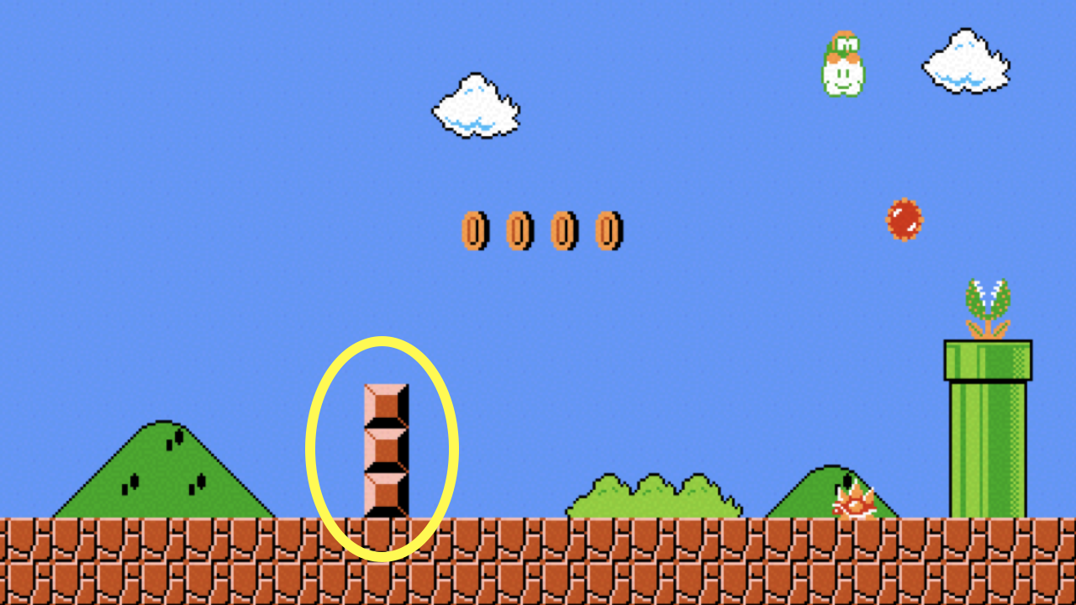
Notes:
mario2.c

Slide 46
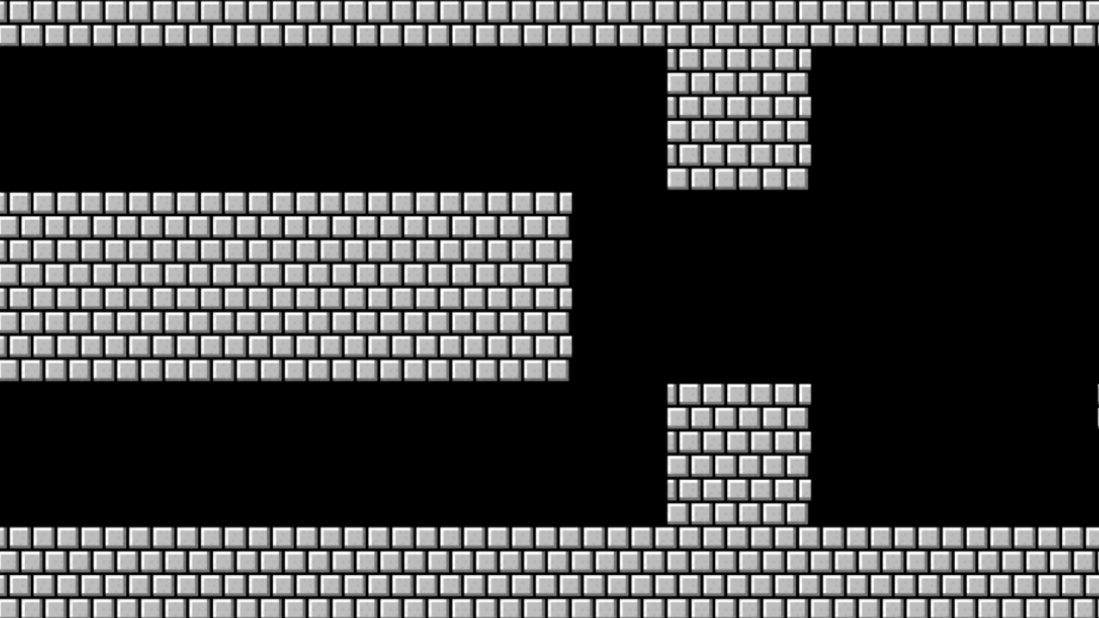

Slide 47
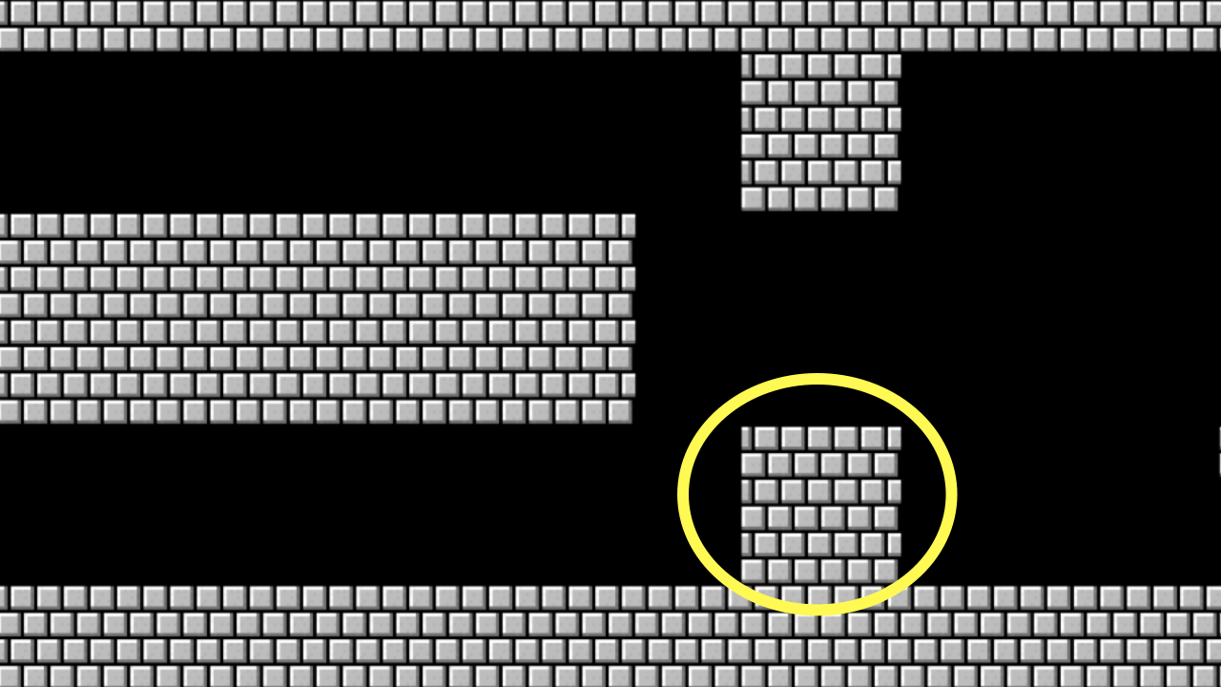
Notes:
mario{3,4,5}.c

Slide 48
constants

Slide 49
comments

Slide 50
function
arguments →
→ return value

Slide 51
+
-
*
/
%
…
Notes:
calculator*.c

Slide 52
integer overflow

Slide 53
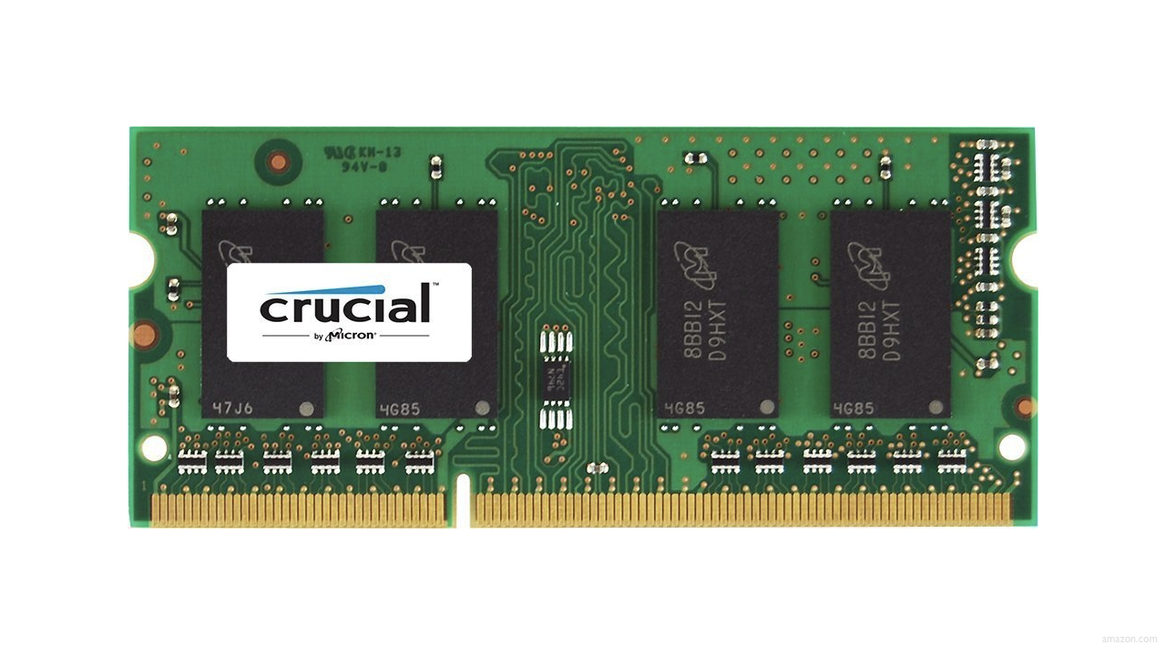

Slide 54
0000

Slide 55
0001

Slide 56
0010

Slide 57
0011

Slide 58
0100

Slide 59
0101

Slide 60
0110

Slide 61
0111

Slide 62
1000

Slide 63
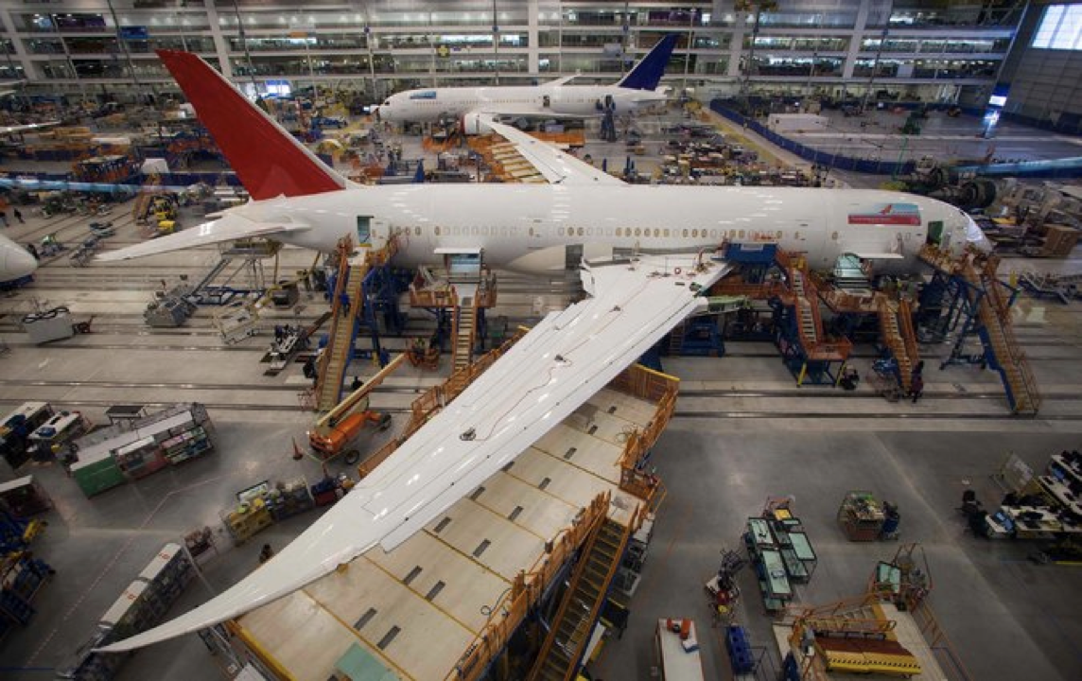
Notes:
Boeing 787
"a Model 787 airplane that has been powered continuously for 248 days can lose all alternating current (AC) electrical power due to the generator control units (GCUs) simultaneously going into failsafe mode," the memo stated. "This condition is caused by a software counter internal to the GCUs that will overflow after 248 days of continuous power... Boeing is in the process of developing a GCU software upgrade that will remedy the unsafe condition." - http://arstechnica.com/information-technology/2015/05/boeing-787-dreamliners-contain-a-potentially-catastrophic-software-bug/
A simple guess suggests the the problem is a signed 32-bit overflow as 2^31 is the number of seconds in 248 days multiplied by 100, i.e. a counter in hundredths of of a second.
https://www.i-programmer.info/news/149-security/8548-reboot-your-dreamliner-every-248-days-to-avoid-integer-overflow.html

Slide 64
truncation

Slide 65
floating-point imprecision
Notes:
1/3

Slide 66
1999
Notes:
graduated

Slide 67
1999

Slide 68
1900

Slide 69
19 January 2038

Slide 70
13 December 1901

